Slide 1


Tập Huấn Robot Buổi 1
Nguyễn Châu Tấn Cường - 23146007

Slide 2
Content
01
02
03
04
05
06
Arduino Uno
IR Infrared Obstacle Avoidance
Ultrasonic HC-SR04
Motor Shield L293D
RC Servo
Line Follower Contest

Slide 3
01
Arduino Uno

Slide 4
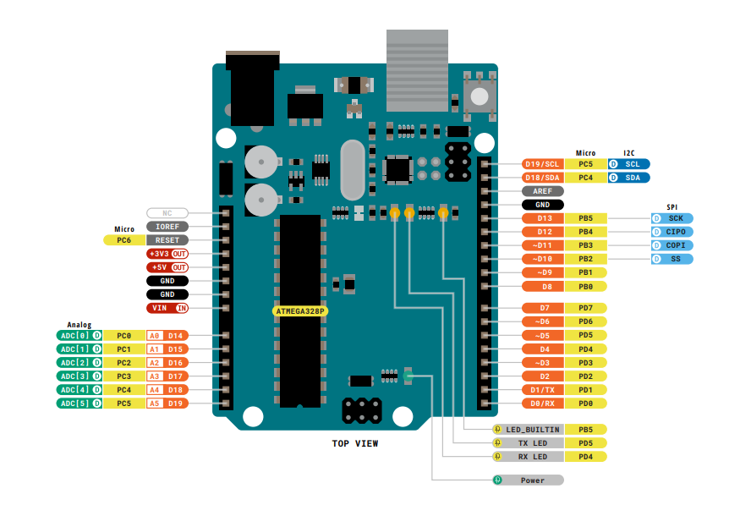
Link : PinOut
Link : Datasheet

Slide 5
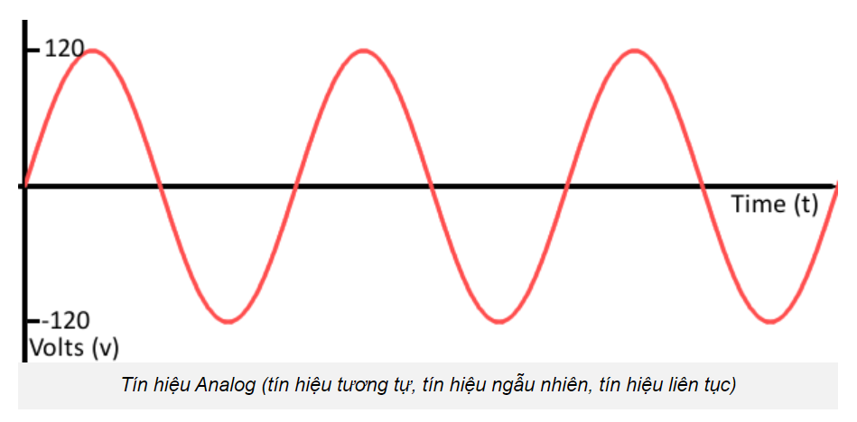
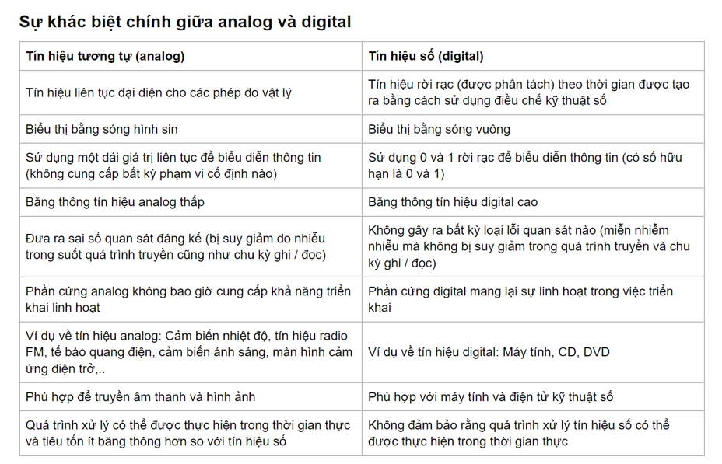
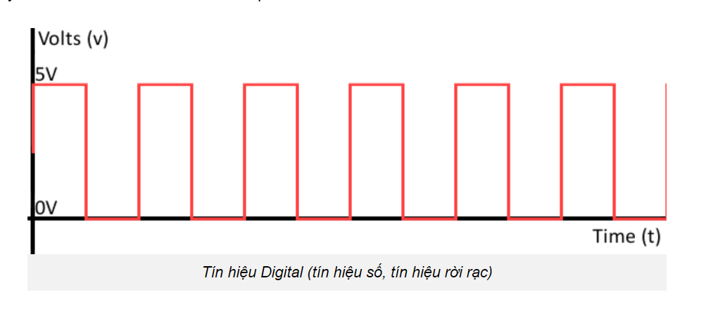
Link : Datasheet

Slide 6
02
IR Infrared Obstacle Avoidance

Slide 7
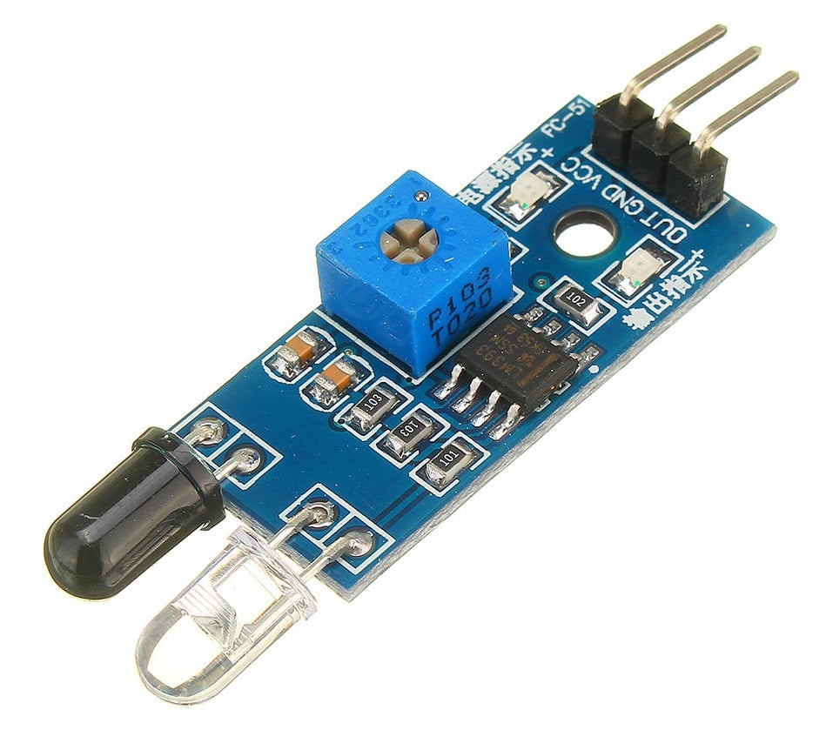
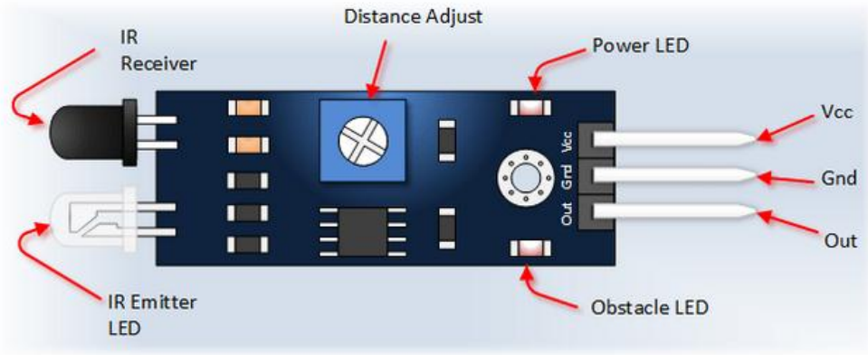
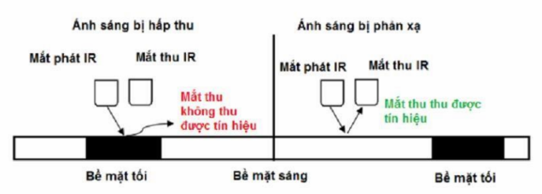
Link : Datasheet

Slide 8
03
Ultrasonic HC-SR04

Slide 9
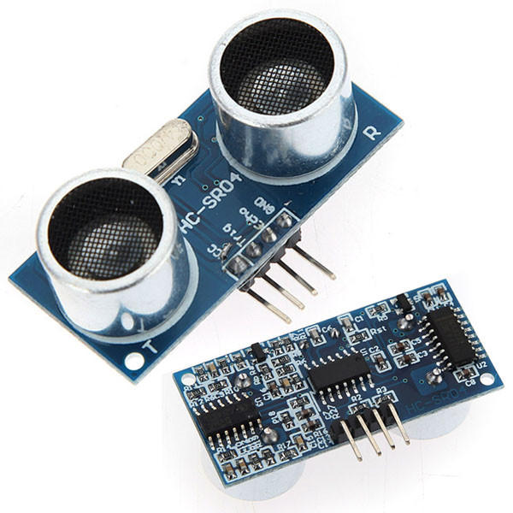
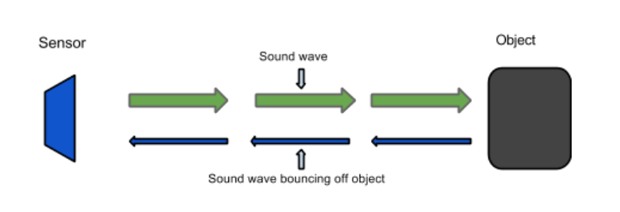
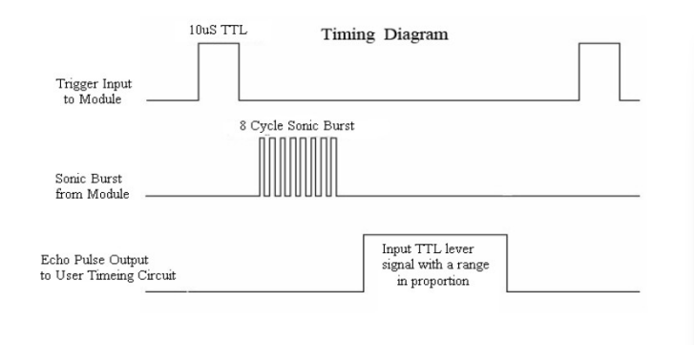
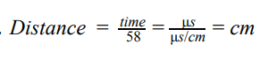
Link : Datasheet

Slide 10
04
Motor Shield L293D

Slide 11
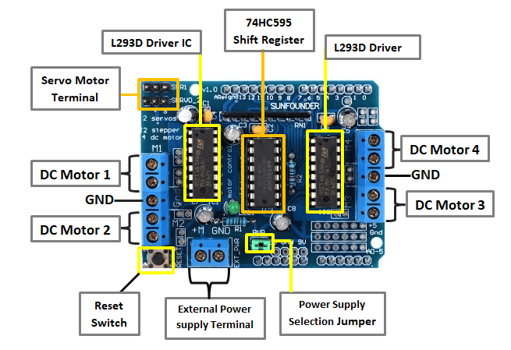
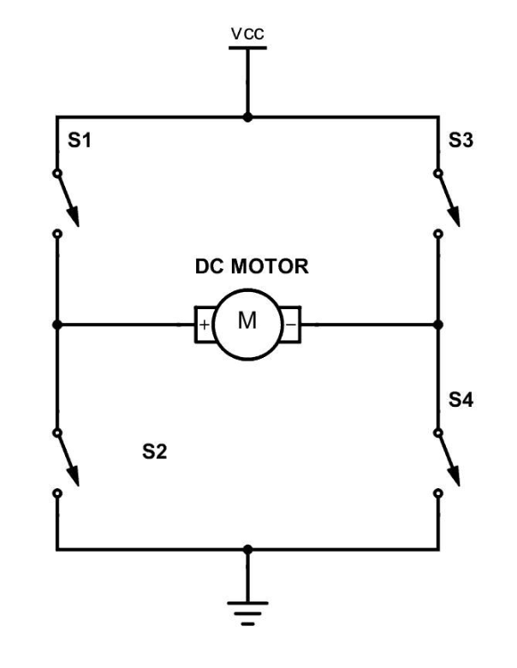
Link : Datasheet

Slide 12
05
RC Servo

Slide 13
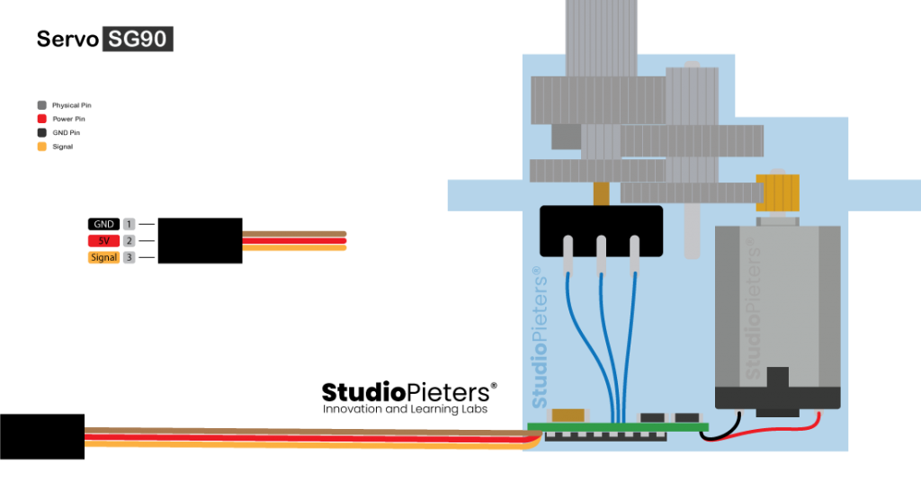
Link : Datasheet

Slide 14
06
Line Follower Contest

Slide 15
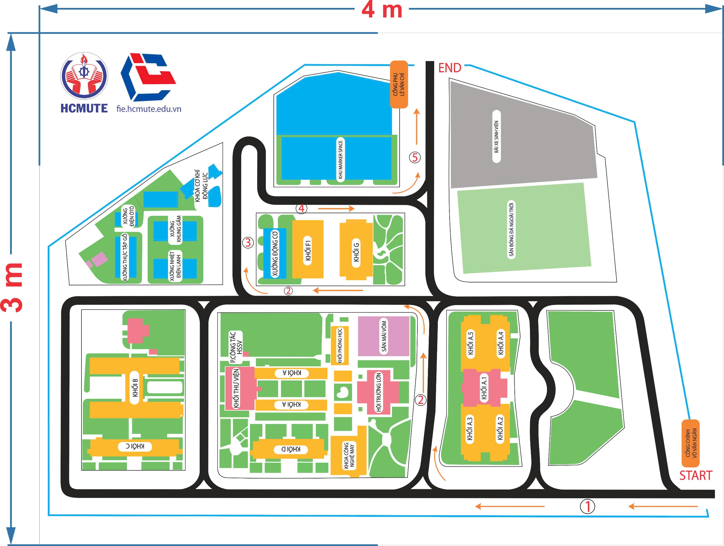

Slide 16
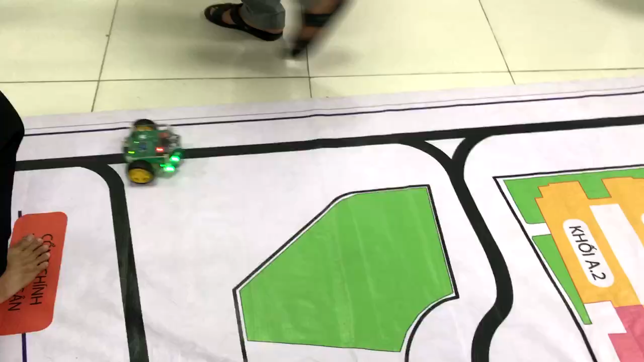

Slide 17
